Slide 1



University of Basrah
Al-Zahraa Medical College
Ministry of higher Education and Scientific Research
Academic year 2026-2025
Student Selective Components
Recognize how the microbes can be distinguished
This Lecture was prepared by module Staff:
•Dr. Ban M. Saleh
• Dr. Hussein K. Abdul-Sada
• Dr. Abeer L. Mohammed
• Dr. Wameedh Hashim Alqatrani
• Dr. Hazim T. Thwiny
Dr. Zainab Khalid
•Dr. Farqad M. Al-Hamdani
• Dr. Shant A. Harotonian
Jawetz, Melnick, & Adelberg’s Medical Microbiology, 28th Edition
Clinical Microbiology and Immunology

Slide 2
University of Basrah
Al-Zahraa Medical College
Ministry of higher Education and Scientific Research
Objectives:
Why we need to identify types of microbes.
Identifying microbes through Look, Growth, Stain and Strain.
What steps should the doctor used to understand the types of microbes.
-Site of infection
- type of samples
- direct smear
- culture
- antibiotic sensitivity
- take a right decision.

Slide 3
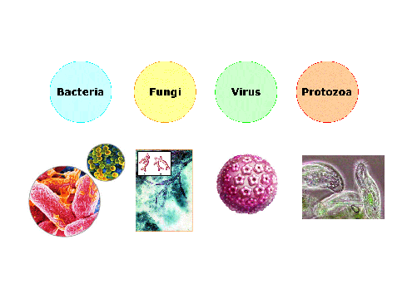
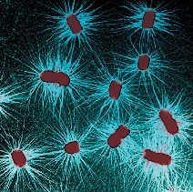
Define microbes
University of Basrah
Al-Zahraa Medical College
Ministry of higher Education and Scientific Research
Microbes are tiny living things that are found all around us and are too small to be seen by the naked eye.
They live in water, soil, and in the air.
The human body is home to millions of these microbes too, also called microorganisms.
Some microbes make us sick, others are important for our health.
Infectious diseases are caused by microorganisms, such as bacteria, viruses fungi and parasites.
3

Slide 4
Identification of microorganisms
University of Basrah
Al-Zahraa Medical College
Ministry of higher Education and Scientific Research
Provides the name of the organism (to genus or species level), which can help in determining whether it is a safety or spoilage concern or is likely to be heat resistant.
Doctors suspect an infection based on
the person's symptoms.
physical examination results.
risk factors. First, doctors confirm that the person has an infection rather than another type of illness.
4

Slide 5
University of Basrah
Al-Zahraa Medical College
Ministry of higher Education and Scientific Research
Once doctors confirm that the person has an infection, they usually need to know which specific microorganism is causing the infection. Many different microorganisms can cause a given infection. For example, pneumonia can be caused by viruses, bacteria, or, rarely, fungi. The treatment is different for each microorganism.
5

Slide 6
Traditional Methods for Identifying Microbes
University of Basrah
Al-Zahraa Medical College
Ministry of higher Education and Scientific Research
Macroscopic Features
Macroscopic features encompass the overall appearance of a microorganism, including its shape, size, color and smell (i.e. the features that you can see with the naked eye).
You can often determine the type of microorganism by examining the gross morphological/macroscopic features on an agar culture.
6

Slide 7
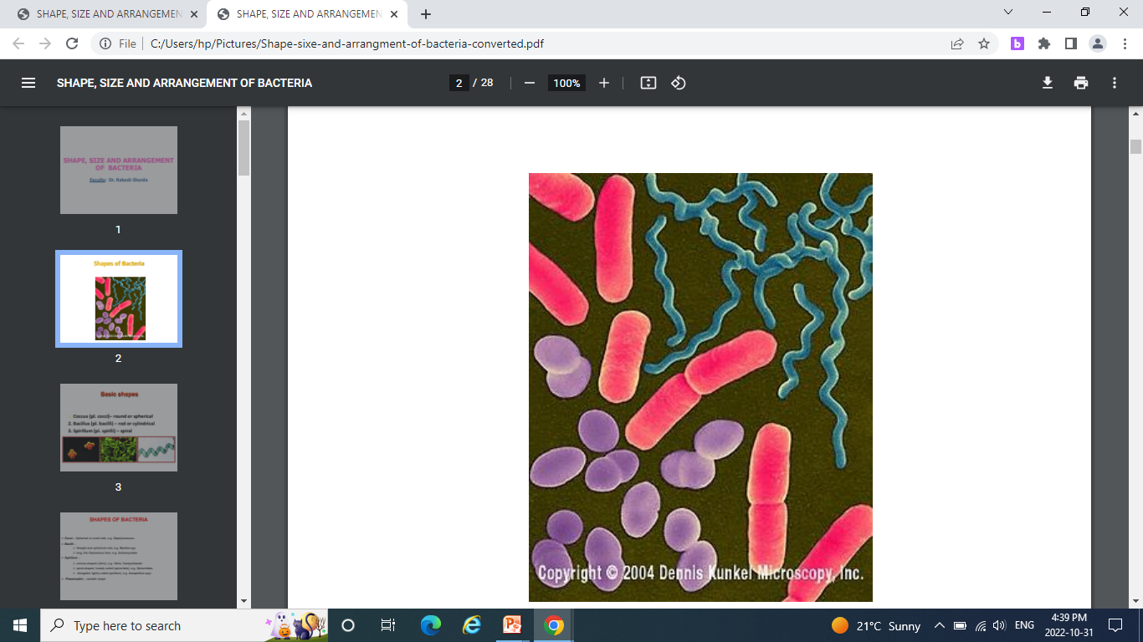
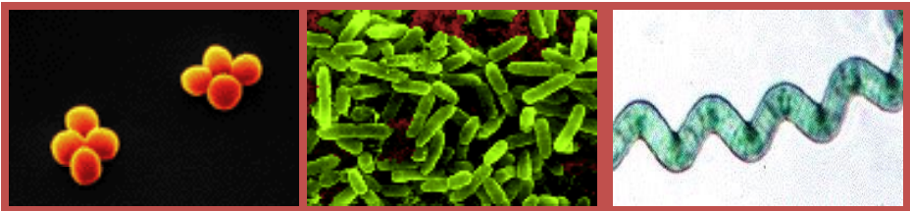
Shapes of Bacteria
University of Basrah
Al-Zahraa Medical College
Ministry of higher Education and Scientific Research
Basic shapes
1. Coccus (pl. cocci)– round or spherical
2. Bacillus (pl. bacilli) – rod or cylindrical
3. Spirillum (pl. spirlli) – spiral
7

Slide 8
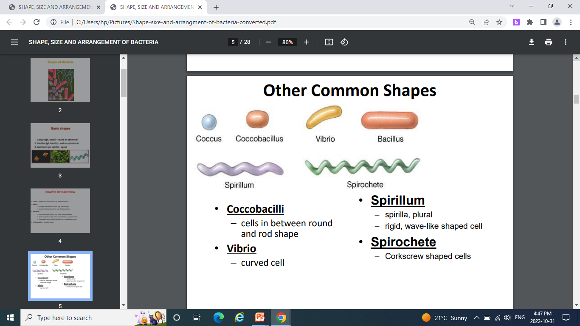
University of Basrah
Al-Zahraa Medical College
Ministry of higher Education and Scientific Research
8

Slide 9
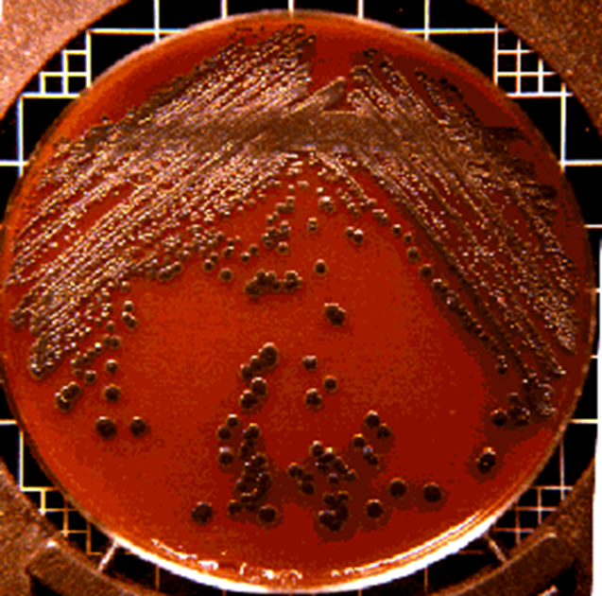
University of Basrah
Al-Zahraa Medical College
Ministry of higher Education and Scientific Research
What does bacteria look like on an agar plate?
On agar plates, bacteria grow in collections of cells called colonies. Each colony arises from a single bacterium or a few bacteria. Although individual cells are too small to be viewed, masses of cells can be observed. Colonies can have different forms, margins, elevations, and colors.
Most bacterial colonies appear white, cream, or yellow in color, and fairly circular in shape
9

Slide 10
Staining and Microscopy
University of Basrah
Al-Zahraa Medical College
Ministry of higher Education and Scientific Research
Stains enable easier visualization under a microscope.
Doctors sometimes can identify a microorganism simply by looking at it under a microscope.
Most samples are treated with stains. Stains are special dyes that color the microorganisms, causing them to stand out from the background. Some microorganisms have a distinctive size, shape, and stained color that enable doctors to recognize them.
However, many microorganisms look alike and cannot be distinguished using a microscope. Also, there must be enough of them, and they must be large enough to be seen with a microscope. For example, viruses cannot be identified using a microscope because they are too small.
10

Slide 11
University of Basrah
Al-Zahraa Medical College
Ministry of higher Education and Scientific Research
Bacteria are classified as follows:
Gram-positive (they look blue because they retain the violet Gram stain).
Gram-negative (they look red because they do not retain the stain).
Doctors can sometimes decide what antibiotics to use based on whether bacteria are gram-positive or gram-negative. Gram-positive and gram-negative bacteria tend to be susceptible to different groups of antibiotics.
11

Slide 12
University of Basrah
Al-Zahraa Medical College
Ministry of higher Education and Scientific Research
Gram stain
Is a differentiated stain used to stain the bacterial cell wall. In this method we used a basic dye crystal violet which stain all bacteria to appear violet in color.
Iodine, which acts as mordant dye ,it increase the affinity between the bacterial cell wall and the stain. 95% alcohol for decolorization.
Safranin is the counter stain which stain the decolorized bacteria giving it a pink /red color.
The main difference in the cell wall between gram +ve & - ve bacteria is the concentration of peptedoglycan in the cell wall.
Gram + ve cell wall contain a high concentration of peptidoglycan while gram –ve cell wall has low concentration.
12

Slide 13
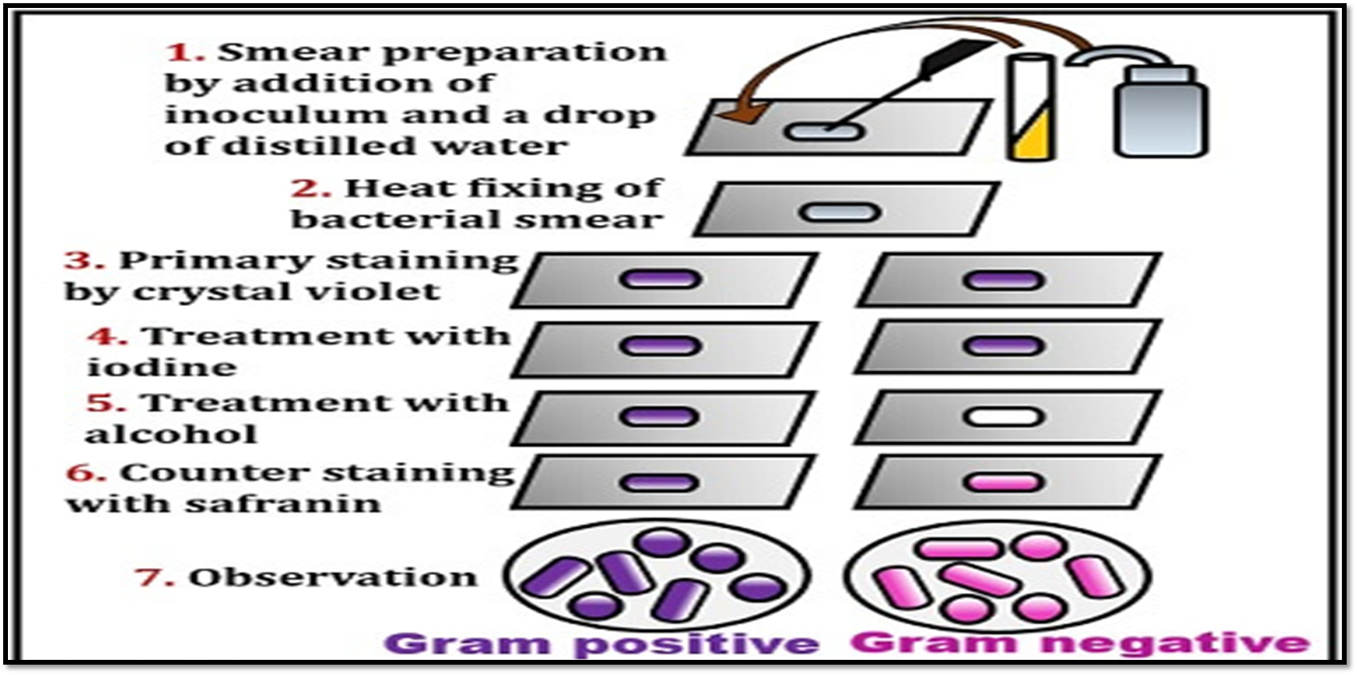
University of Basrah
Al-Zahraa Medical College
Ministry of higher Education and Scientific Research
Gram stain technique

Slide 14
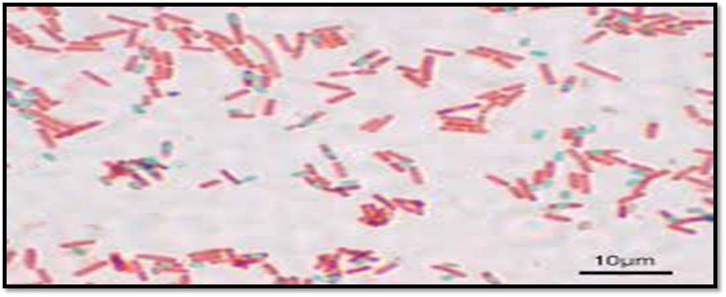
Endospore Staining
University of Basrah
Al-Zahraa Medical College
Ministry of higher Education and Scientific Research
This involves applying a stain to a bacterial sample to check for the presence of spores. Because not all bacteria produce spores, this information can be useful in identification. Several spore stains are available, but malachite green is probably the most popular.
14

Slide 15
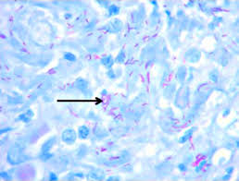
Ziehl-Neelsen Staining
University of Basrah
Al-Zahraa Medical College
Ministry of higher Education and Scientific Research
This is an important tool for the staining of Mycobacterium tuberculosis (TB), which can’t be Gram-stained. The red stain carbol fuchsin is used first, followed by a counterstain such as methylene blue. M. tuberculosis stain red while other bacteria stain blue.
15

Slide 16
Samples for Testing
University of Basrah
Al-Zahraa Medical College
Ministry of higher Education and Scientific Research
A sample is taken from an area of the person's body likely to contain the microorganism suspected of causing the infection. Samples may include:
Blood
Sputum
Urine
Stool
Tissue
Cerebrospinal fluid
Mucus from the nose, throat, or genital area
16

Slide 17
University of Basrah
Al-Zahraa Medical College
Ministry of higher Education and Scientific Research
Some samples sent for testing, such as sputum, stool, and mucus from the nose or throat, normally contain many types of bacteria that do not cause disease. Doctors need to distinguish between these bacteria and those that could cause the person's illness.
Other samples come from areas that normally do not contain any microorganisms (that are sterile), such as urine, blood, or cerebrospinal fluid (the fluid that surrounds the brain and spinal cord). Finding any bacteria in such samples is abnormal as long as the area from which the sample was taken was first cleaned with an antiseptic to prevent contamination.
17

Slide 18
University of Basrah
Al-Zahraa Medical College
Ministry of higher Education and Scientific Research
Culture of Microorganisms
Many samples contain too few microorganisms to be seen using a microscope or to be identified using other tests. Thus, doctors usually try to grow the microorganism in a laboratory (called culture) until there are enough to identify.
The sample is placed on a sterile dish (plate) or in a test tube that contains specific nutrients to encourage growth of microorganisms. Different nutrients are used depending on which microorganism doctors suspect is causing the infection. Often, doctors add substances to the dish or test tube to stop the growth of microorganisms that do not cause the disease doctors suspect.
18

Slide 19
University of Basrah
Al-Zahraa Medical College
Ministry of higher Education and Scientific Research
Many microorganisms, such as the bacteria that cause urinary tract infections, can easily be grown in a culture.
Some bacteria, such as the bacteria that cause syphilis, cannot be cultured at all.
Other bacteria, such as those that cause tuberculosis, and fungi can be cultured but take weeks to grow.
Some viruses can be cultured, but many cannot.
After the microorganisms are cultured, tests to identify them and to determine susceptibility and sensitivity to antimicrobial drugs are done.
19

Slide 20

University of Basrah Al-zahraa medical college
Ministry of higher Education and Scientific Research
Culture media
Culture media are the materials which are used for cultivation and growing of different types of bacteria in the laboratory.
A culture medium contains water, a source of carbon & energy, source of nitrogen, trace elements and some growth factors. Besides these, the pH of the medium must be set accordingly.
20

Slide 21
University of Basrah Al-zahraa medical college
Ministry of higher Education and Scientific Research
Some of the ingredients of culture media include water, agar, peptone, casein, meat extract, yeast extract.
Bacterial culture media can be classified into:
Based on consistency
Based on nutritional component
Based on its functional use.
21

Slide 22

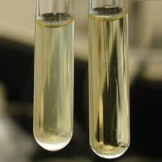
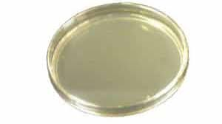
University of Basrah Al-zahraa medical college
Ministry of higher Education and Scientific Research
Classification based on consistency (solidity):
A) Liquid media: nutrient broth
B) Solid media (Petri dish- Slant)
C) Semi-solid agar: Oxidation fermentation tests-motility medium
Nutrient agar
Nutrient broth
slant
22

Slide 23


University of Basrah Al-zahraa medical college
Ministry of higher Education and Scientific Research
Classification based on functional use or application:
Basal media are basically simple media that supports most non-fastidious bacteria. Peptone water, nutrient broth and nutrient agar considered basal medium.
Nutrient broth
Nutrient agar
23

Slide 24
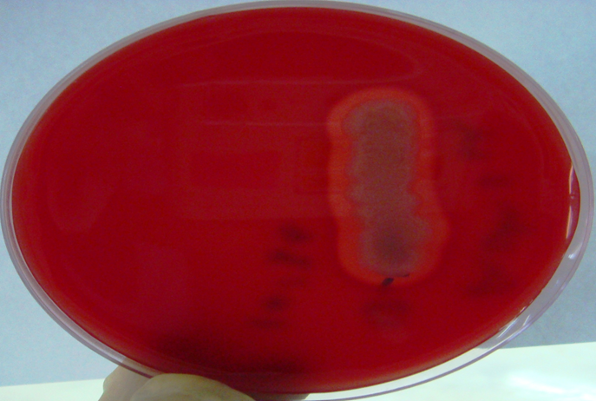
University of Basrah Al-zahraa medical college
Ministry of higher Education and Scientific Research
B. Enriched media: It is enriched with special nutrition requirement for cultivation of fastidious bacteria. Addition of extra nutrients in the form of blood, serum, egg yolk etc., to basal medium makes them enriched media. Such as blood agar, chocolate agar (which prepared from heating of blood).
Blood agar
24

Slide 25
University of Basrah Al-zahraa medical college
Ministry of higher Education and Scientific Research
C) Selective media are designed to inhibit unwanted commensal or contaminating bacteria It is used to select type of bacteria for cultivation from other types of bacteria. Selective media contain ingredients that inhibit the growth of certain types of bacteria and/or encourage the growth of others.
• MacConkey agar for cultivation of gram negative bacteria.
• Salmonella Shigella agar (SS agar) for cultivation of Salmonella and Shigella.
• Mannitol salt agar for cultivation of Staphylococcus according to high salt concentration (NaCl 7.5 %) which inhibit the growth of other bacteria.
25

Slide 26
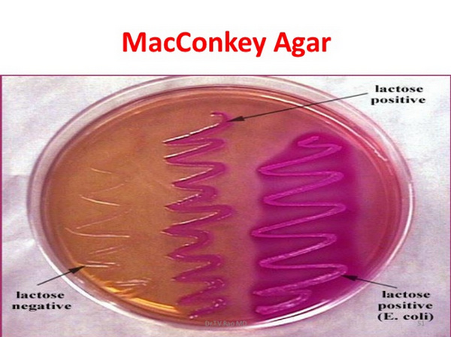
University of Basrah Al-zahraa medical college
Ministry of higher Education and Scientific Research
D) Differential media or indicator media:
Certain media are designed in such a way that different bacteria can be recognized on the basis of their colony colour.
-MacConkey’s agar which differentiate between genus of the family Enterobacteraceae (gram negative bacteria) to lactose fermenter (appear pink like Escherichia coli, Klebsiella and Enterobacter) and non lactose fermenter (appear pale like Salmonella, Shigella and Proteus).
26

Slide 27
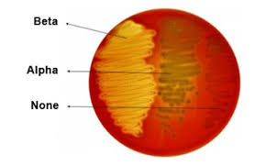
University of Basrah Al-zahraa medical college
Ministry of higher Education and Scientific Research
--Blood agar differentiate between beta-hemolytic bacteria (complete hemolytic) like Streptococcus pyogen, alpha–hemolytic bacteria (partial hemolytic) like Streptococcus pneumoniae and non hemolytic bacteria like Streptococcus faecalis.
27

Slide 28
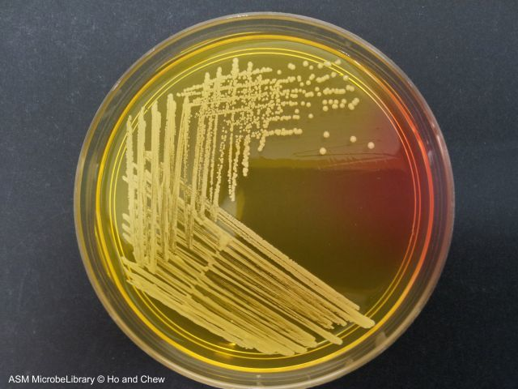
University of Basrah Al-zahraa medical college
Ministry of higher Education and Scientific Research
-Mannitol salt agar differentiate between Staphylococcus aureus (mannitol fermenter appear yellow ) and other Staphylococcus species (non-mannitol fermenter).
28

Slide 29
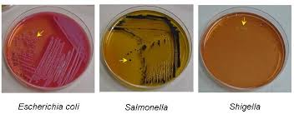
University of Basrah Al-zahraa medical college
Ministry of higher Education and Scientific Research
-Salmonella Shigella agar (SS agar) for differentiate between Salmonella (uncolored with black center for release H2S ) and Shigella (uncolored only)
29

Slide 30
University of Basrah Al-zahraa medical college
Ministry of higher Education and Scientific Research
E) Transport media: Clinical specimens must be transported to the laboratory immediately after collection to prevent overgrowth of contaminating organisms or commensals. Such media prevent drying (desiccation) of specimen, maintain the pathogen to commensal ratio and inhibit overgrowth of unwanted bacteria. Some of these media are semi-solid in consistency.
F) Assay media used for testing of antibiotic such as Muller-Hinton agar.
G) Maintenance media
H) Enumeration media
30

Slide 31
University of Basrah Al-zahraa medical college
Ministry of higher Education and Scientific Research
Classification based on nutritional component:
While most of the nutritional components are constant across various media, some bacteria need extra nutrients. Those bacteria that are able to grow with minimal requirements are said to non-fastidious and those that require extra nutrients are said to be fastidious. Simple media such as peptone water, nutrient agar can support most non-fastidious bacteria.
Complex media such as blood agar have ingredients whose exact components are difficult to estimate.
31

Slide 32
University of Basrah
Al-Zahraa Medical College
Ministry of higher Education and Scientific Research
Microorganism's Susceptibility and Sensitivity to Antimicrobial Drugs
susceptibility testing is done to determine how effective various antimicrobial drugs are against the specific microorganism infecting the person. This testing helps doctors determine which drug to use for a particular person's infection.
Cultures are often used for susceptibility testing. Once a microorganism has been grown in a culture, doctors add different antimicrobial drugs to see which ones kill the microorganism. They also test how sensitive the microorganism is to a drug—that is, whether a small or a large amount of a drug is needed to kill the microorganism (sensitivity testing). If a large amount is needed to kill the microorganism in the laboratory, doctors usually do not use that drug.
32

Slide 33
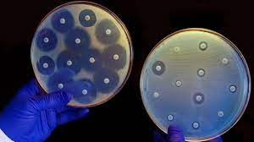
University of Basrah
Al-Zahraa Medical College
Ministry of higher Education and Scientific Research

Slide 34
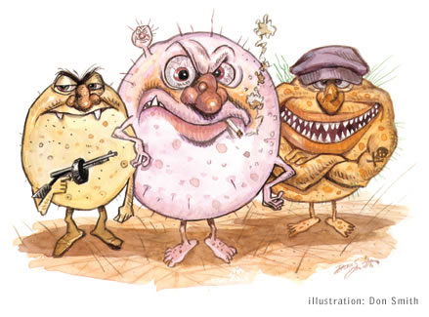
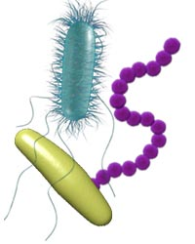
Thank you

